Slide 1
Android Compiling process

Slide 2
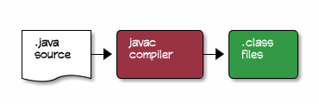
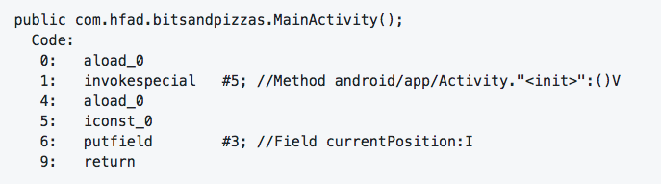
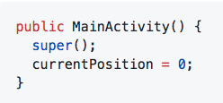
1) Compile Java Source to .class file

Slide 3
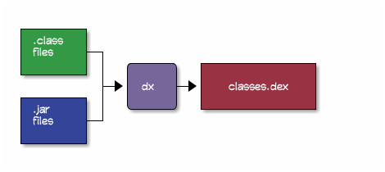
2) Conversion to Dalvik bytecodes
The .class files contain standard Oracle JVM Java byte-codes. But Android devices don’t use this byte-code format. Instead, Android has its own distinct byte-code format called Dalvik. Dalvik byte-codes, like Oracle JVM byte-codes, are machine-code instructions for a theoretical processor.
The compilation process needs to convert the .class files, and any .jar libraries into a single classes.dex file containing Dalvik byte-codes. This is done with the dx command:

Slide 4
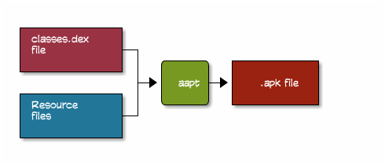
3) Put classes.dex and resources into a package file
The classes.dex file and the resources from your application, such as images and layouts, are then compressed into a zip-like file called an Android Package or .apk file.

